Slide 1
Math Mashups

Slide 27
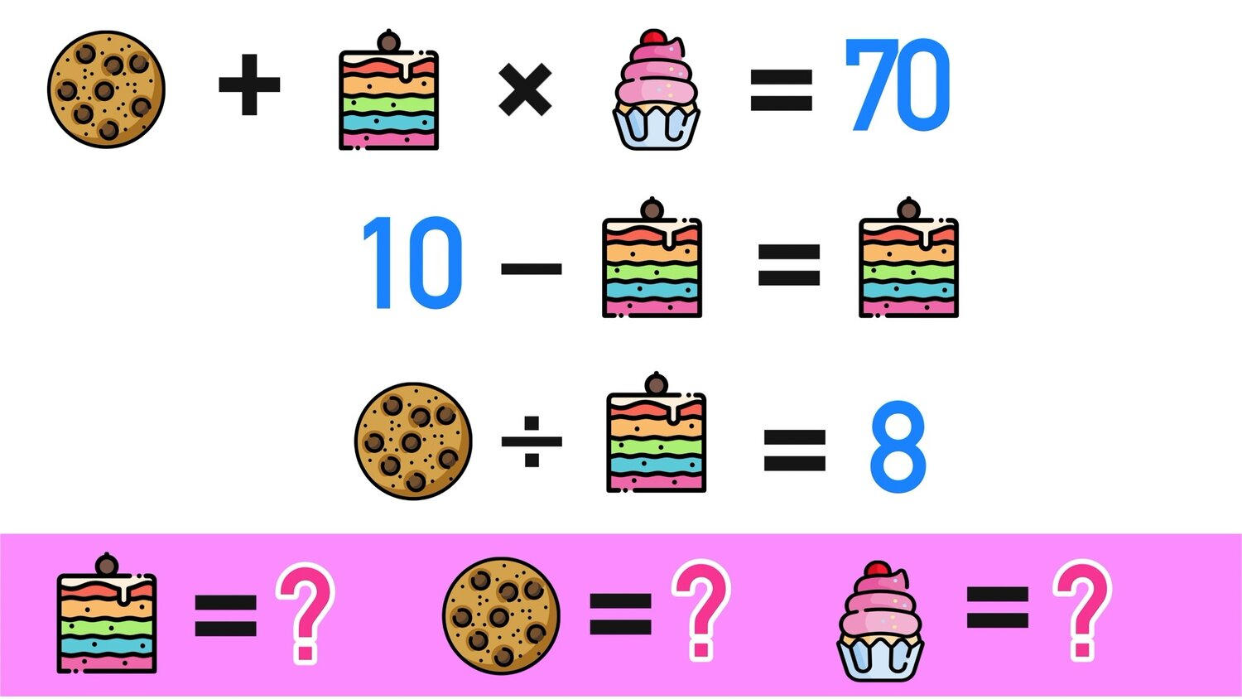

Slide 32
